Slide 1
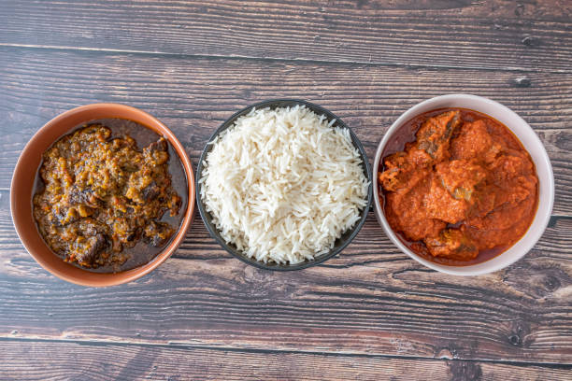
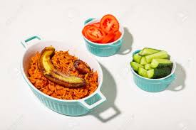
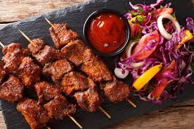
CANTEEN
UNILEVER
ORDERING SYSTEM
By John Aigbonohan

Slide 2
Executive Summary
In the bid to find a lasting solution to the inefficiencies around the meal management and catering services raising employee happiness, and streamlining operational procedures, the proposed Canteen Ordering System seeks to completely transform our current lunchtime procedures. This business case shows the strong arguments for putting this system in place as well as how it might affect worker output and overall organisational effectiveness.

Slide 3
Business Objective
Maximise Operational Efficiency
Create a smooth delivery system, enhance kitchen processes, and reduce food waste.
03
01
Employee Productivity
Increase overall productivity by saving employees the
valuable time they would otherwise spend on the lunch procedure.
Enhance Employee Experience
Shorten wait times, provide a wider selection of food, and streamline the lunch experience as a whole to increase employee happiness.
02

Slide 4


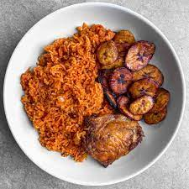

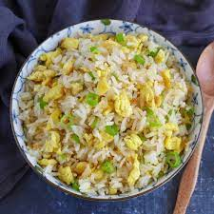
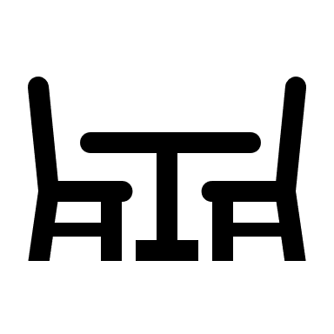

Future Enhancement
More Interactive and attractive user interface.
Flexible Payment should staff exceed their salary before month end.
Table Reservation.
​
Other activities can be added. ​

Slide 5
Expected Benefits
With a streamlined ordering process and effective meal delivery, employees will spend less time on lunch-related duties.
The new system will give staff members access to a large menu, guaranteeing a greater variety of food options and lowering discontent brought on by shortages.
The system will greatly reduce the quantity of food wasted by matching the demand with the actual orders, which will benefit the organizations finances as well as the environment.
Having more control over meal selections and having a more enjoyable lunch experience may raise employee satisfaction, which may improve staff retention.
Time Efficiency
Better Food Options
Less Food Wastage
Employee Satisfaction and Retention

Slide 6
Possible Challenges
Overcoming Resistance
to Change
Technical Problems
Integration Challenges
Conduct in-depth training sessions to acquaint staff members with the new system and resolve any issues.
Work with the IT division to make sure the system is stable and dependable and that backup procedures are in place in case something goes wrong.
Work closely with the payroll division to incorporate the deduction procedure into the current payroll system as smoothly as possible.

Slide 7
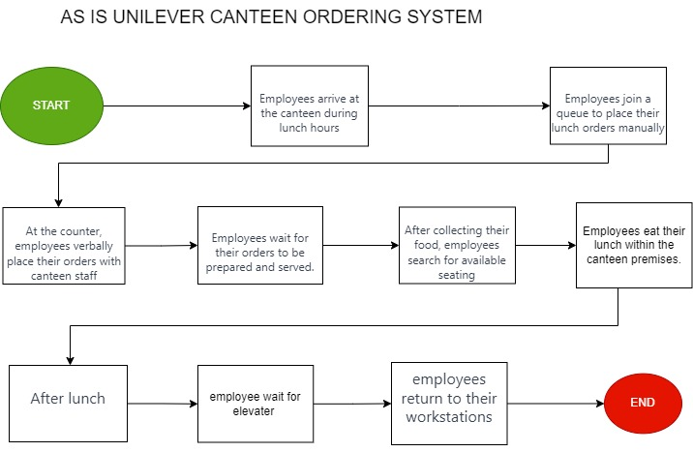
Process Flow

Slide 8
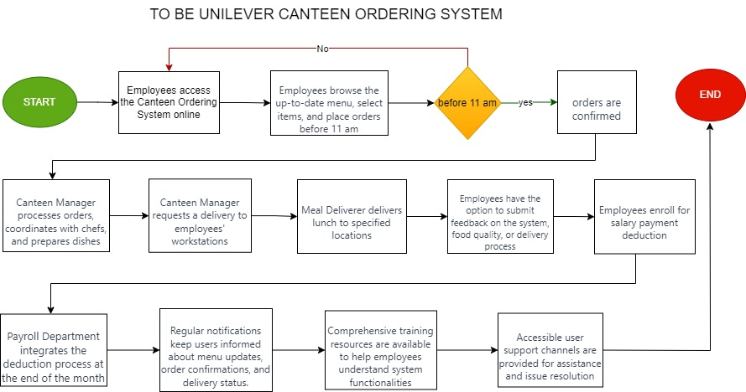
Process Flow
END
START

Slide 9
Raci Matrix
Task/Activity | Project Manager | IT Department | Canteen Management | HR Department | Delivery Boy | Chefs | Employees | Supervisors/Managers | Payroll Department
Project Planning | R (Responsible) | A (Accountable) | C (Consulted) | I (Informed) | I | I | C | C | C
System Development | R | A | C | I | I | I | C | C | I
Menu Creation/Update | R | C | A | I | I | C | I | C | I
Employee Training | R | C | A | I | I | I | R | I | I
Order Processing | R | C | A | I | I | C | I | I | I
Delivery Coordination | R | I | C | I | A | I | I | I | I
Feedback Handling | R | C | A | I | I | I | R | I | I
Enrolment Process | R | I | C | A | I | I | R | I | A
Integration with Payroll | R | A | I | C | I

Slide 10







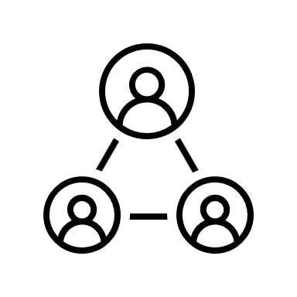
Employees
Canteen Management (Menu Manager, Order Processor)
Users providing feedback
Senior Management
Impacted Stakeholders
Chef
IT Department (for System Implementation and Maintenance)
Delivery Personnel
HR Department (for Payroll deductions)

Slide 11
Stakeholder matrixes
Stakeholder | Interest | Impact on System | Justifications
Employees | High interest, high power | High | Primary users, affected by efficiency and service
Canteen Management | High interest, high power | High | Directly involved in system operation
Chefs | Low interest, High power | Medium | Impacted by order volume and preparation time
Delivery Personnel | High interest, low power | Medium | Affected by delivery coordination
HR Department | Low interest, low power | Medium | In charge of payroll deductions
IT Department | High interest, high power | High | Responsible for system implementation and maintenance
Senior Management | High interest, high power | High | Decision-makers, funding approval
Feedback Providers | Low interest, Low power | Low | Provide insights for system improvement

Slide 12
Problems with the current process
01
Ineffective Lunch Process
Workers must wait a long-time during lunch, which wastes time and reduces production.
Limited Food Options
When there are shortages in the canteen, employees frequently cannot get their favourite foods.
Food Wastage
The canteen wastes money and resources by throwing away a large volume of unsold food.
02
03

Slide 13
Objectives of the new canteen ordering system
01
Reduce Wait Times
Minimize the time employees spend in queues and waiting for tables during lunch hours.
02
Increase Food Variety
Ensure a broader selection of dishes to cater to employees' preferences and reduce shortages.
Reduce Food Wastage
03
Reduce Food Wastage
Reduce needless food disposal by putting in place an effective ordering system that matches demand.

Slide 14
Objectives of the new canteen ordering system
04
Improve Employee Satisfaction
Enhance the overall lunch experience, providing more control and choices to employees.
05
Streamline Delivery Process
Establish a smooth and timely delivery system to employees' workstations.
06
Implement Feedback Mechanism
Allow employees to provide feedback on the system, food quality, and delivery process.

Slide 15
Objectives of the new canteen ordering system
07
Ensure Payroll Integration
Facilitate a seamless deduction process from Reduce employees' salaries for the ordered dishes at the end of the month

Slide 16
Main features to be developed in this new System
User authentication.
Menu management.
Order placement.
Order confirmation.
Order processing.
Delivery coordination.
Feedback mechanism.
Enrolment for salary deduction.
Reporting and analytics.
User support.
User communication.
Training module.
System security.
Accessibility .
Integration with payroll system.
Error handling.
Audit trail.
Scalability.
Compliance.
Offline mode.

Slide 17
Translate the To-Be Requirements into User Stories.
As an employee, I want to log in securely to the canteen ordering system so that only authorized user can access the platform.
As an employee, I want the option to select and order lunch items from menu, with the flexibility to edit or modify my order before 11am cut off time.
As an employee, I want to browse an up-to-date menu with detailed dish information and prices, ensuring I can make informed choices.
As an employee, I want the options to select and order lunch items from the menu, with the flexibility to edit or modify my order before the 11am cut off time.
As an employee, I want to receive a confirmation once my order is placed, ensuring that I am aware that my order is being process and prepared.
As a canteen manager, I want to view and process employee orders efficiently, coordinating with chefs for timely preparation.

Slide 18
Translate the To-Be Requirements into User Stories.
As a canteen manager, I want the ability to request a delivery to employee’s workstations, ensuring a seamless and timely delivery process.
As a meal deliverer (delivery boy), I want to receive information about the orders to be delivered and close online customer orders after successful delivery.
As an employee, I want the option to provide feedback on the system, food quality, or delivery process to contribute to continuous improvement.
As an employee, I want to enrol in the salary payment deduction system to ensure a hassle-free payment process for ordered dishes.
As the payroll department, I want the canteen ordering system to integrate seamlessly with the payroll system for automated deduction at the end of the month.
As an employee, I want to receive regular notification about menu updates, order confirmations, and delivery status to stay informed.

Slide 19
Translate the To-Be Requirements into User Stories.
As an employee, I want access to comprehensive training resources to understand the functionalities of the canteen ordering system.
As an employee, I want accessible user support channels to seek assistance and resolve any issues related to the canteen ordering system.
As a system administrator, I want robust security measures in a place to protect user data and ensure secure transaction within the platform.
As a canteen manager, I want the ability to create and update the menu, ensuring it reflects the available dishes and prices for the day.
As an employee, I want the flexibility to place orders or view menus in offline mode, with the system syncing once back online.
As a canteen manager, I want reporting and analytics feature to generate insights into system performance, popular dishes, and user trends.

Slide 20
Translate the To-Be Requirements into User Stories.
As a canteen manager, I want effective error handling mechanism in place to address issues in real-time and provide user-friendly error messages.
As a system administrator, I want to maintain an audit trail for all transactions and actives within the canteen ordering system for accountability and traceability.
As a system administrator, I want to ensure the canteen ordering system complies with data protection regulations and other relevant legal requirement.

